Slide 1
CS 211 Computer Architecture Lecture 13: RISC-V Instructions – Logical and shift operations
Ravi Mittal
ravi.mittal@iitgoa.ac.in
Indian Institute of Technology, Goa

Slide 2
Acknowledgements
Class Presentation, CS61C, Introduction to Assembly Language and RISC-V Instruction Set Architecture, University of Berkeley, Prof Krste Asanović & Randy H. Katz. http://inst.eecs.Berkeley.edu/~cs61c
Class Presentation, CS61C, Introduction to Machine Language, University of Berkeley, Branden Ghen, Fall 2019 http://inst.eecs.Berkeley.edu/~cs61c
Computer Organization and Design, The Hardware Software Interface, RISC-V edition, Patterson and Hennessey
Digital Design and Computer Architecture: RISC-V Edition, Harris & Harris Elsevier – Presentation.

Slide 3
The Previous class
Basic Arithmetic Instructions
add, sub
Immediate Instructions
addi
Data Transfer Instructions
lw, sw
lh, sh
lb, sb

Slide 4
Load Word: lw instruction
lw <rd>, <offset>(<base register>)
Destination register
Offset
Base Register
Operation code (opcode)
Example: lw t1, 4(s0)
Address calculation:
add offset (4) to the base address (s0)
Offset field is sign extended field )(can also be negative)
address = (s0 + 4)
Destination register (rd):
t1 holds the value at address (s0 + 4)
Any register may be used to hold the base address

Slide 5
RISC-V Instructions
add x1, x2, x3 # x1 = x2 + x3
sub x1, x2, x3 # x1 = x2 - x3
addi x3,x4,-10 # x3 = x4 – 10
CS 211: Computer Architecture

Slide 6
Loading and Storing Bytes
In addition to word data transfers (lw, sw), RISC-V has byte data transfers:
load byte: lb
store byte: sb
Same format as lw, sw
E.g., lb x10,3(x11)
contents of memory location with address = sum of “3” + contents of register x11 - is copied to the low byte position of register x10
x10:
xxxx xxxx xxxx xxxx xxxx xxxx
zzz zzzz
x
byte loaded
…is copied to “sign-extend”
This bit
Ref: Prof Krste Asanović & Randy H. Katz, Univ of California, Berkeley

Slide 7
Example: Sign Extension
-2 = - (010)₂ = (110)_{two’s compliment} = (1110)_{two’s compliment} = (11110)_{two’s compliment} = (11..1110)_{two’s compliment}
-3 = - (011)₂ = (101)_{two’s compliment} = (1101)_{two’s compliment} = (11101)_{two’s compliment} = (11..11101)_{two’s compliment}

Slide 8
Unsigned Instructions (self reading)
lhu reg, off(bAddr)“load half unsigned”
lbu reg, off(bAddr)“load byte unsigned”
On l(b/h)u, upper bits are filled by zero-extension
Why no s(h/b)u? Why no lwu?

Slide 9
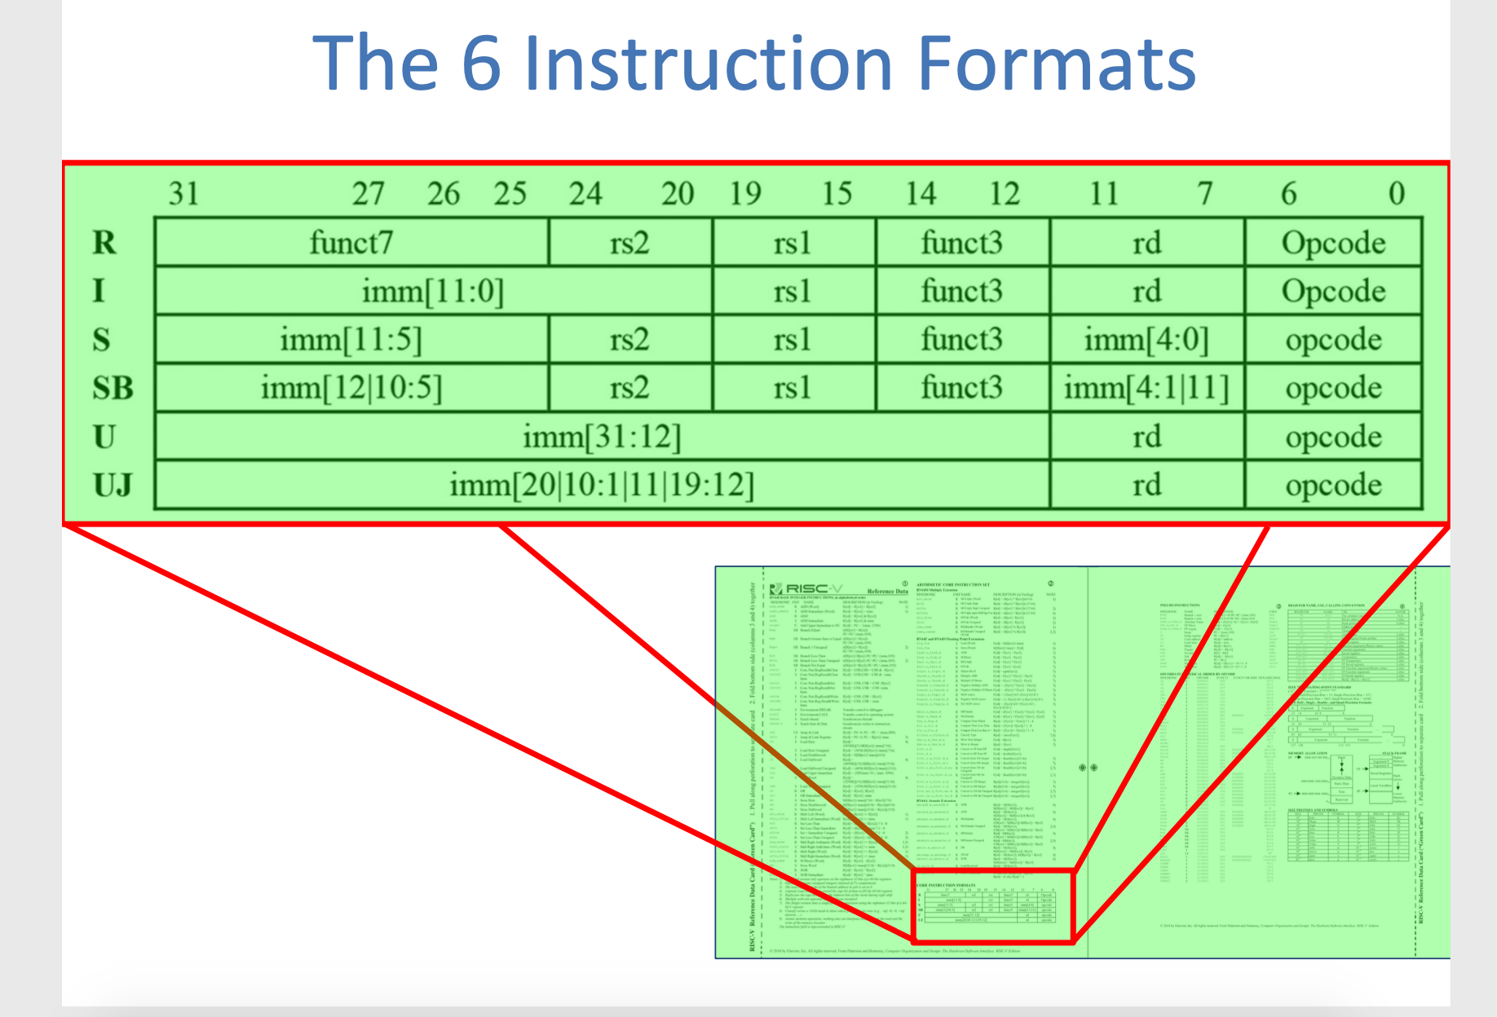
RISC-V Logical Instructions
Ref: Steven Ho, CS61C Su18 - Lecture 7 Univ of California, Berkeley
Notes:
CS61C Su18 - Lecture 7

Slide 10
In today’s class we will study
Bit-by-bit logical instructions
and, or, xor
andi, ori, xori
Logical Shift instructions
sll, srl, sra
Slli, srli, srai

Slide 11
Your turn
addi x11,x0,0x3f5
sw x11,0(x5)
lb x12,1(x5)
What is the value in x12?
Ref: Prof Krste Asanović & Randy H. Katz, Univ of California, Berkeley

Slide 12
Your turn
addi x11,x0,0x3f5
sw x11,0(x5)
lb x12,1(x5)
 | 0x5
 | 0xf
 | 0x3
 | 0xffffffff
Ref: Prof Krste Asanović & Randy H. Katz, Univ of California, Berkeley

Slide 13
Logical Instructions and, or, xor

Slide 14
RISC-V Logical Instructions
Useful to operate on fields of bits within a word
e.g., characters within a word (8 bits)
Operations to pack /unpack bits into words
Called logical operations
Logical operations | C operators | Java operators | RISC-V instructions
Bit-by-bit AND | & | & | and
Bit-by-bit OR | | | | | or
Bit-by-bit XOR | ^ | ^ | xor
Shift left logical | << | << | sll
Shift right logical | >> | >> | Srl
Shift right arithmetic |  |  | sra
Adapted from: Prof Krste Asanović & Randy H. Katz, Univ of California, Berkeley

Slide 15
RISC-V Bitwise Instructions
Note: a→s1, b→s2, c→s3
Instruction | C | RISCV
and | a = b & c; | and s1,s2,s3
and Immediate | a = b & 0x1; | andi s1,s2,0x1
or | a = b | c; | or s1,s2,s3
or Immediate | a = b | 0x5; | ori s1,s2,0x5
exclusive Or | a = b ^ c; | xor s1,s2,s3
Exclusive Or Immediate | a = b ^ 0xF; | xori s1,s2,0xF

Slide 16
Logical Instructions
and, or, xor
and: useful for masking bits
Masking all but the least significant byte of a value:
0xF234012F AND 0x000000FF = 0x0000002F
or: useful for combining bit fields
Combine 0xF2340000 with 0x000012BC:
0xF2340000 OR 0x000012BC = 0xF23412BC
xor: useful for inverting bits:
A xor -1 = NOT A (remember that -1 = 0xFFFFFFFF)
Ref: Harris and Harris Book: Digital Design and Computer Architecture: RISC-V Edition

Slide 17
Logical Instructions – Example 1
Ref: Harris and Harris Book: Digital Design and Computer Architecture: RISC-V Edition

Slide 18
Logical Instructions – immediate
-1484 = 0xA34 in 12-bit 2’s complement representation.
Ref: Harris and Harris Book: Digital Design and Computer Architecture: RISC-V Edition

Slide 19
Logical Instructions - shift operations

Slide 20
Shift Instructions
sll: shift left logical
Example: sll t0, t1, t2 # t0 = t1 << t2
Insert 0s on the left side by shift amount
srl: shift right logical
Example: srl t0, t1, t2 # t0 = t1 >> t2
Insert 0s on the right side by shift amount
sra: shift right arithmetic
Example: sra t0, t1, t2 # t0 = t1 >>> t2
Insert copy of msb bit on the right side
Shift amount is in (lowest 5 bits of) a register. Shift amount is between 0 and 31
Ref: Harris and Harris Book: Digital Design and Computer Architecture: RISC-V Edition

Slide 21
sll: Shift left logical - Example
addi t2, zero, 0x4
addi t1, zero,0xA
sll t0, t1, t2 # moves the bits left by 4 position
Value of t1 is:
0000 0000 0000 0000 0000 0000 0000 0000 0000 0000 0000 0000 0000 0000 0000 1010
Value of t2 is:
0000 0000 0000 0000 0000 0000 0000 0000 0000 0000 0000 0000 0000 0000 0000 0100
We will shift bits of t1 by 4 position to left (given by lower 5 bits of t2 : 00100)
Value of t0 after execution of sll is:
0000 0000 0000 0000 0000 0000 0000 0000 0000 0000 0000 0000 0000 0000 1010 0000
The value of t0 reg after sll by 4 position is: 10*16

Slide 22
Shift right logical - Example
addi t2, zero, 0x4
addi t1, zero,0xA3
srl t0, t1, t2 # moves the bits left by 4 position
Value of t1 is:
0000 0000 0000 0000 0000 0000 0000 0000 0000 0000 0000 0000 0000 0000 1010 0011
Value of t2 is:
0000 0000 0000 0000 0000 0000 0000 0000 0000 0000 0000 0000 0000 0000 0000 0100
We will shift bits of t1 by 4 position towards right (given by lower 5 bits of t2 : 00100)
Value of t0 after execution of srl is:
0000 0000 0000 0000 0000 0000 0000 0000 0000 0000 0000 0000 0000 0000 0000 1010
The value of t0 reg after sll by 4 position is: 10
shift right logical is division (integer) by 2⁴ ??
Ref: Harris and Harris Book: Digital Design and Computer Architecture: RISC-V Edition

Slide 23
Try srl on a negative number
Symbols for operations:
<< x : logical shift left by x positions
>> x : logical shift right by x positions
>>> x : arithmetic shift right by x positions
Let’s try operation srl on a negative number
(-4₁₀) >> 1 = (1100_{two’s comp}) >> 1 = 0110_{two’s comp} = 6₁₀ For signed values, the division result is wrong..
Use Arithmetic shift : replicates sign bits on the left side

Slide 24
sra: Shift right arithmetic
Same as a logical right shift, but on right shifts it fills the most significant bits with a copy of the old most significant bit (msb)
Arithmetic shift replicates sign bits on the left side
(-4₁₀) >>>1 = (1100_{two’s comp})>>>1 = 1110_{two’s comp} = -2₁₀
Try this operation on odd negative number
(-5₁₀) >>> 1 = (1011₂)>>>1 = 1101₂ = -3₁₀
Shift right arithmetic is not exactly a division.. It fails for odd negative numbers
Example: sra t2, t1, t3

Slide 25
Immediate Shift Instruction
Shift amount is an immediate between 0 to 31
slli: shift left logical immediate
Example: slli t0, t1, 23 # t0 = t1 << 23
srli: shift right logical immediate
Example: srli t0, t1, 18 # t0 = t1 >> 18
srai: shift right arithmetic immediate
Example: srai t0, t1, 5 # t0 = t1 >>> 5
Ref: Harris and Harris Book: Digital Design and Computer Architecture: RISC-V Edition

Slide 26
Immediate Shift Instruction: Example
Shift Left Logical - immediate:
slli x11,x12,2 #x11=x12<<2
Store in x11 the value from x12 shifted 2 bits to the left (they fall off end), inserting 0’s on right; << in C
Before: 0000 0002_{hex} 0000 0000 0000 0000 0000 0000 0000 0010_{two}
After: 0000 0008_{hex} 0000 0000 0000 0000 0000 0000 0000 1000_{two}
Shift Right Logical- immediate:
srli is opposite shift; >>
Zero bits inserted at left of word, right bits shifted off end
Prof Krste Asanović & Randy H. Katz, Univ of California, Berkeley

Slide 27
Arithmetic Shifting: srai
Shift right arithmetic (srai) moves n bits to the right (insert high-order sign bit into empty bits)
For example, if register x10 contained
1111 1111 1111 1111 1111 1111 1110 0111_{two}= -25_{ten}
If execute sra x10, x10, 4, result is:
1111 1111 1111 1111 1111 1111 1111 1110_{two}= -2_{ten}
Note that this is NOT same as dividing by 2^{n}
Fails for odd negative numbers
Prof Krste Asanović & Randy H. Katz, Univ of California, Berkeley

Slide 28
Example: lb using lw
# lb using lw: lb s1,1(s0)
lw s1,0(s0) # get word
andi s1,s1,0xFF00 # get 2nd byte
srli s1,s1,8 # shift into lowest
Ref: Branden Ghena, Univ of California, Berkeley

Slide 29
Class - Summary
Bring data from memory to register and vice versa
lw, sw, lb, sb, lbu
Bit-by-bit logical instructions
and, or, xor
andi, ori, xori
Logical Shift instructions
sll, srl, sra
Slli, srli, srai

Slide 30
Backup

Slide 31
Shifting Instructions
Instruction Name | RISCV
Shift Left Logical | sll s1,s2,s3
Shift Left Logical Imm | slli s1,s2,imm
Shift Right Logical | srl s1,s2,s3
Shift Right Logical Imm | srli s1,s2,imm
Shift Right Arithmetic | sra s1,s2,s3
Shift Right Arithmetic Imm | srai s1,s2,imm
When using immediate, only values 0-31 are practical
When using variable, only lowest 5 bits are used (read as unsigned)
jRef: Branden Ghena, Univ of California, Berkeley

Slide 32
Example 1: Shifting Instructions
# sample calls to shift instructions
addi t0,x0 ,-256 # t0=0xFFFFFF00
slli s0,t0,3 # s0=0xFFFFF800
srli s1,t0,8 # s1=0x00FFFFFF
srai s2,t0,8 # s2=0xFFFFFFFF
addi t1,x0 ,-22 # t1=0xFFFFFFEA
# low 5: 0b01010
sll s3,t0,t1 # s3=0xFFFC0000
# same as slli s3,t0,10
Ref: Branden Ghena, Univ of California, Berkeley

Slide 33
Example 3: sb using sw
# sb using sw: sb s1,3(s0)
lw t0,0(s0) # get current word
andi t0,t0,0xFFFFFF # zero top byte
slli t1,s1,24 # shift into highest
or t0,t0,t1 # combine
sw t0,0(s0) # store back
Ref: Branden Ghena, Univ of California, Berkeley

